Slide 1
Team Debt
Creators Kaleem, Ankur, Fahad & Rabarb

Slide 2
What are the problems?
From what we have researched from the 2015 Nigerian elections:
Voting was extended due to technical problems, card readers were introduced to prevent voter fraud.
Boko Haram attempted to disrupt the election by attacking voting centres, killing 41 people. One of the candidates, Umaru Ali, was gunned down in one attack.
29,432,083 out of a population of 181.2 million people made a valid vote however, only 67,422,005 are registered to vote which means 37,145,403 did not arrive at their polls to vote.
Not all of the Nigerian Population has a passport but may have other forms of Government issued ID.

Slide 3

How are we solving them?
First – The Application and Access to it:
More than half of the Nigeran population is under 30 making our core target between the ages of 18 to 35.
Our web-application will be lite, very responsive and is compatible to all devices as a majority of the nation owns a mobile phone.
For those who do not have access to such devices, mobile polling stations will be in each state and county where they will be able to go in person, receive help and then complete their voting process.
A website will be used nationally to access, register and to vote on.

Slide 4
How are we solving them?
Second – Online at Home vs. At Polling Booth:
At home process includes completing details and then recording a video for verification which is checked and confirmed manually by staff, however AI can be later implemented to recognize and confirm if it is the user.
At the Polling station a similar process of completing information will occur however, an ID scanner will be present to scan the user’s Government Issued ID, which includes; Nigerian Passport, Nigerian Drivers License Identity Card, Nigeria Voters Card and Nigeria National Identity Card. Connected to the scanner will be a camera that checks in real-time that the image on the ID matches that of the user that is being captured by the camera.
Once the verification and confirmation process has been completed, the user will be given a reference number that they can use to login and vote.

Slide 5

How are we solving them?
Third – Security and Safety:
All votes that are registered will be stored in an encrypted database alongside their personal data that they have entered, they constantly be entering their details on the secured website.
As most of the voters will be doing so from their own homes there will be no need to visit polling stations where they may fear from being harmed, harassed or be put in any form of danger.
If the voters circumstances require them to go to a polling station, the mobile polling station will be available for them to visit. The polling stations are mobile so that they don’t remain in one area and is the only place that can be visited, instead there will be a various amount of stations that can be reached if a problem occurs.

Slide 6
How are we solving them?
Fourth – Last but not least:
A large problem that is faced is Internet connectivity and electricity available in all areas of Nigeria.
In most rural areas such commodities do not exist, to battle this and be able to allow such application to work and be applied into these communities is by creating and using solar powered mobile polling stations, the electricity will created using the solar energy which will supply the energy to keep devices charged and/or running as well as have a Internet connection that can cope with the amount of traffic being sent through during voting period.

Slide 7
Who can fund and help us achieve these goals?
There are many potential companies that may offer us funding or grants in order to create this web-application for Nigeria Elections, some of which include;
Microsoft
CISCO
Tesla
INEC – organize the elections in Nigeria
Another form of raising/funding money for the project is crowdfunding, if the Nigerian population would like to have safer, faster and easier access to vote in their country then money can be raised by ‘Crowdfunding’, not only can the people of Nigeria fund small amounts each but even foreigners who believe and would like to be involved in such change can donate too. Examples of services that allow this are;
Kickstarter
GoFundMe
Crowfunder
Services such as, FUNDSFORNGOS allow you to find grants and donors that are available to you, training videos, sample proposals etc to promote the product you are trying to earn funding to various companies: fundsforngospro.com

Slide 8
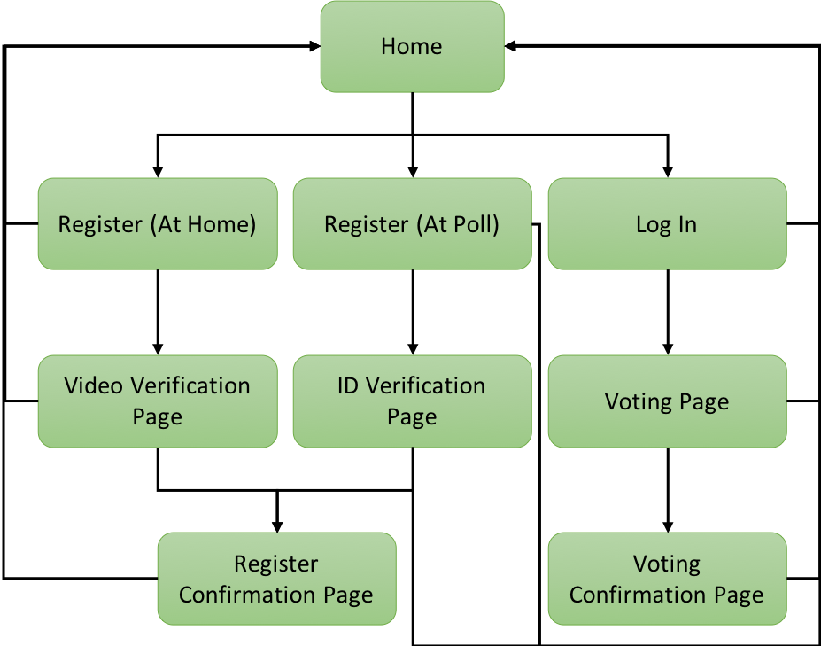
Demonstration of how the web-application would function

Slide 9
References
https://en.wikipedia.org/wiki/Nigerian_general_election,_2015
https://edition.cnn.com/2018/05/31/africa/nigeria-not-too-young-to-run/index.html
www.google.com

